Slide 1
Varying Spacecraft Signatures of Bursty Bulk Flows and Dipolarizing Flux Bundles
J. Raeder, B. Ferdousi, and W. D. Cramer
Space Science Center, University of New Hampshire, Durham, NH
2022 MMS Workshop, ERAU, Daytona Beach, Florida, May 2022

Slide 2
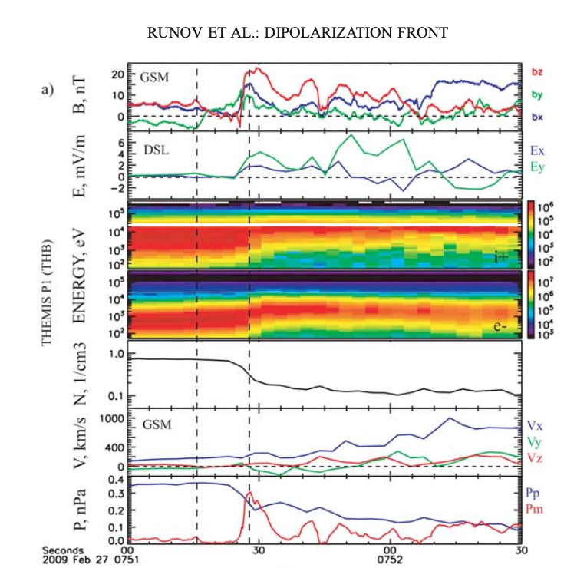
The ‘classic’ BBF/DFB signature
B dipolarization
E burst
N down
V increase to 400+ km/s
T up
Entropy up

Slide 3
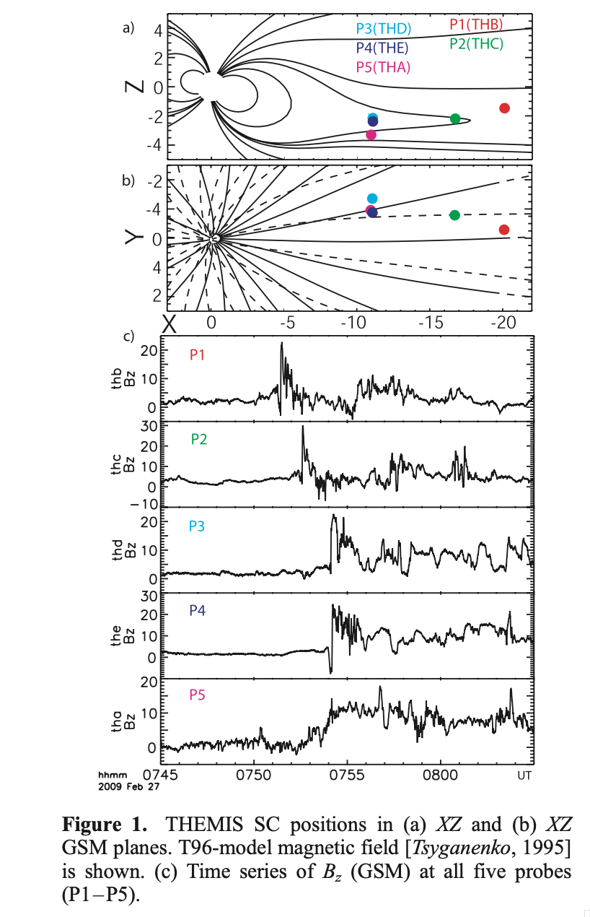
But they don’t look all the same
Runov’s original paper showed 5 different ‘appearences’ of the same DFB.
Just the magnetic field can have sharp/slow rise, negative dip, etc.

Slide 4
Modeling perspective
Vx (top) and Bz (bottom) in the current sheet, defined by Bx=0.
Earth is to the right.
Clear correspondence between flow channels and DFBs.
For a more or less stationary s/c the DFB/BBF can pass by in different ways.
We mark 2 rows of locations and take time series to see how they differ.
Possible BBF/DFB – s/c interactions: frontal, side-swipe, bounce-back, etc.

Slide 5
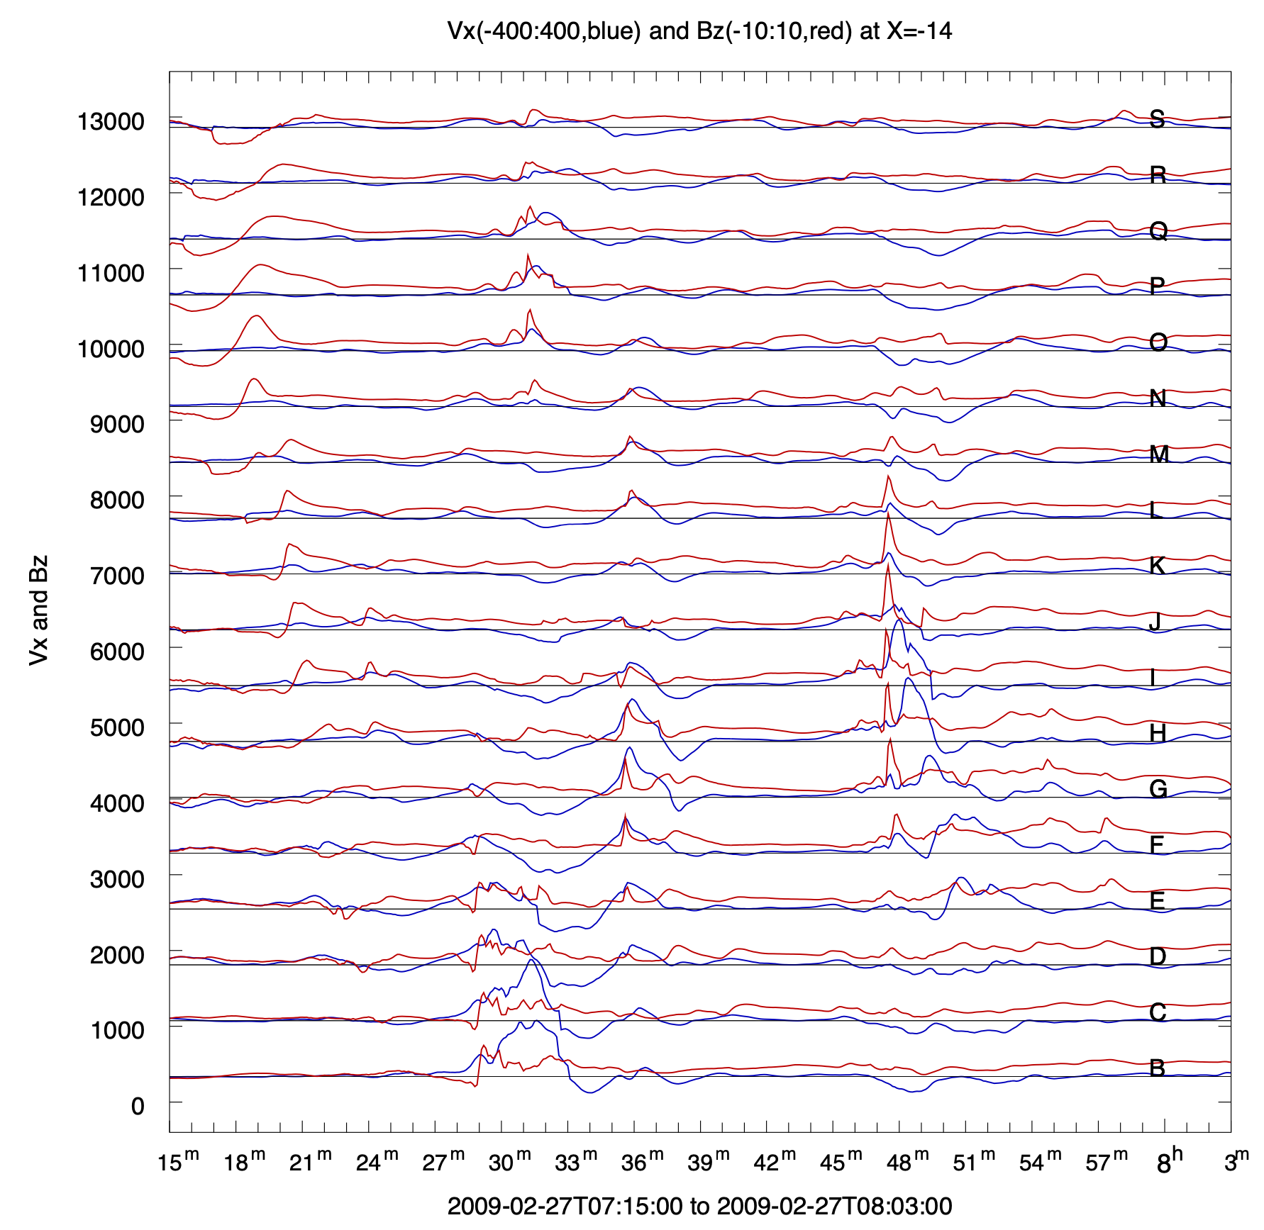
Classification
Type 1: B/C/D early: strong flow, sharp Bz rise, sustained, negative Bz dip in front
Type 2: H/I: strong flow, but only Bz spike, no sustained rise and no negative dip.
Type 3: J/K/L late: sharp Bz spike, but very little flow burst.
Type 4: N/O/P early: No flow enhancement, but Bz negative to positive swing.
Type 5: I/K/L/M early: negative Bz precursor, sharp BZ rise, but no flow enhancement.

Slide 6
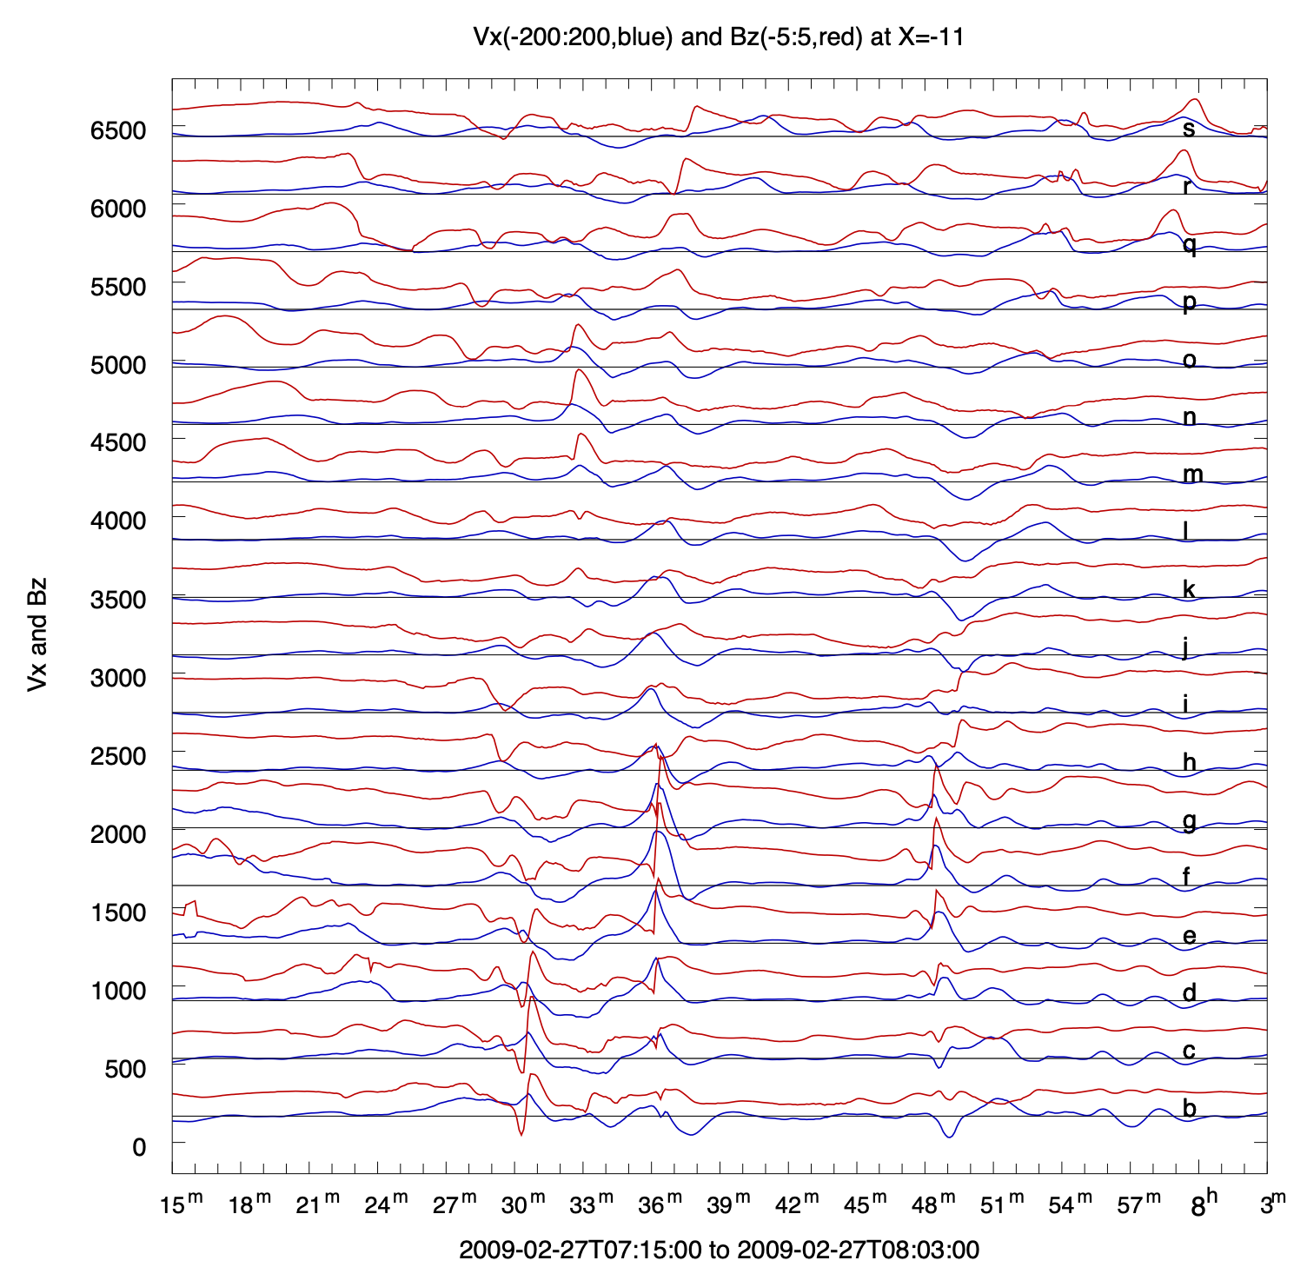
Classification
Different row: x=-14 RE
Type 6: i/j/k/l: flow burst, but no Bz signature.
Type 7: c/d/e/f: flow reversal with dipolar Bz signature, maybe x-line encounter or bounce-back.
That is possibly not all.

Slide 7
Summary and Todo List
Observational signatures of BBF/DFBs differ depending on how a s/c encounters them.
They may often not have the ‘classical’ appearance and not be recognized as BBF/DFBs.
The relation between different signatures and the types of encounters need to be explored.
Other variables (T, N) should also be taken into account.

