Slide 1
Severe Space Weather: Magnetosphere Response and Ionosphere Drivers
J. Raeder, W. D. Cramer, K. Germaschewski and B. Ferdousi
Space Science Center, University of New Hampshire, Durham, NH
N. Maruyama and T. Fuller-Rowell
NOAA Space Weather Prediction Center, Boulder, CO
Chapman on Scientific Challenges Pertaining to Space Weather Forecasting Including Extremes
Pasadena, CA, February 11-15, 2019

Slide 2
Abstract
Extreme space weather events are extremely rare, but pose a significant threat to our infrastructure. The one known event of such kind was the Carrington storm of 1859, but it was not well documented; in particular the solar wind and IMF conditions that caused it remain guesses. However, the STEREO-A observations of July 23, 2012 showed solar wind and IMF parameters that are most likely comparable to those of the Carrington event, and remind us that such extreme events are very well possible now. Here, we use OpenGGCM simulations of such events to assess the effects of such solar wind and IMF on the magnetosphere. Precious work has shown that during the much more benign Halloween storm the nose of the magnetopause was as close as 4.9 RE, with an accordingly large polar cap. We will present simulations of a sequence of made-up storms with increasingly larger driving and demonstrate the further expansion of the polar cap, and the eventual saturation. In addition, we will show how the ionosphere potential penetrates to lower latitudes and affects the ionosphere and thermosphere at mid latitudes when the solar wind drivers become extreme.

Slide 3
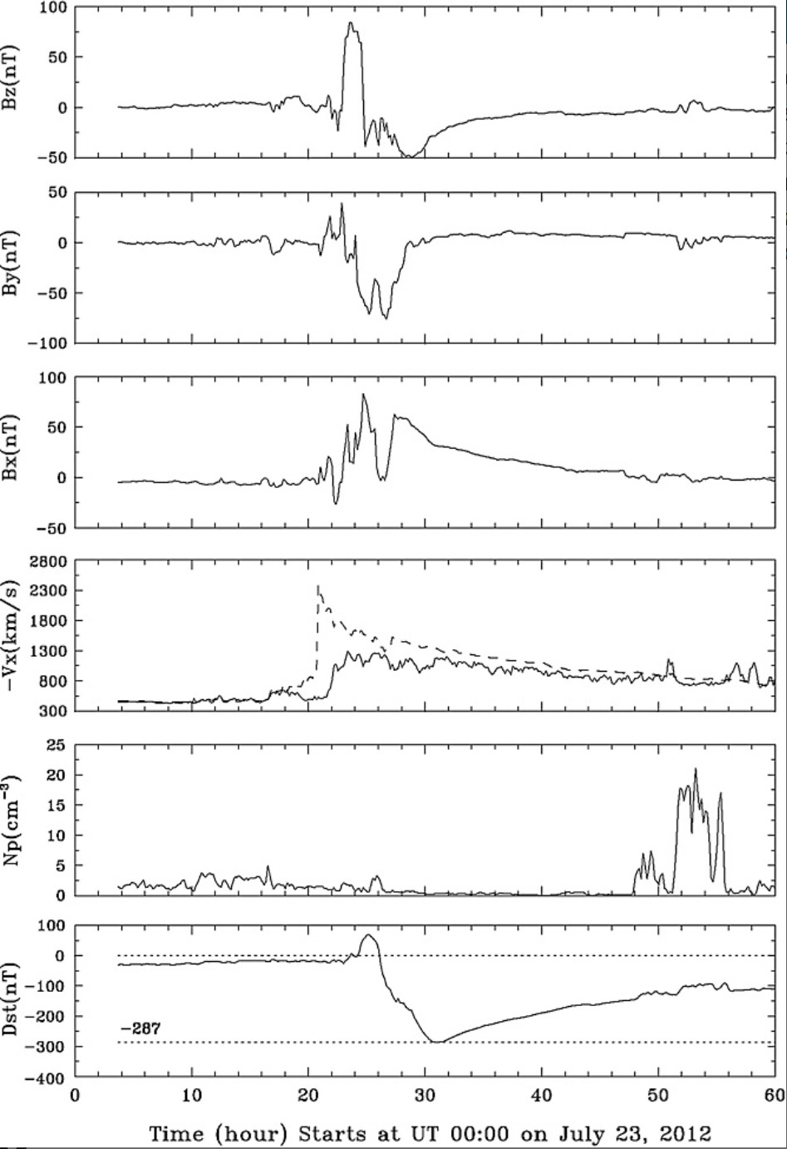
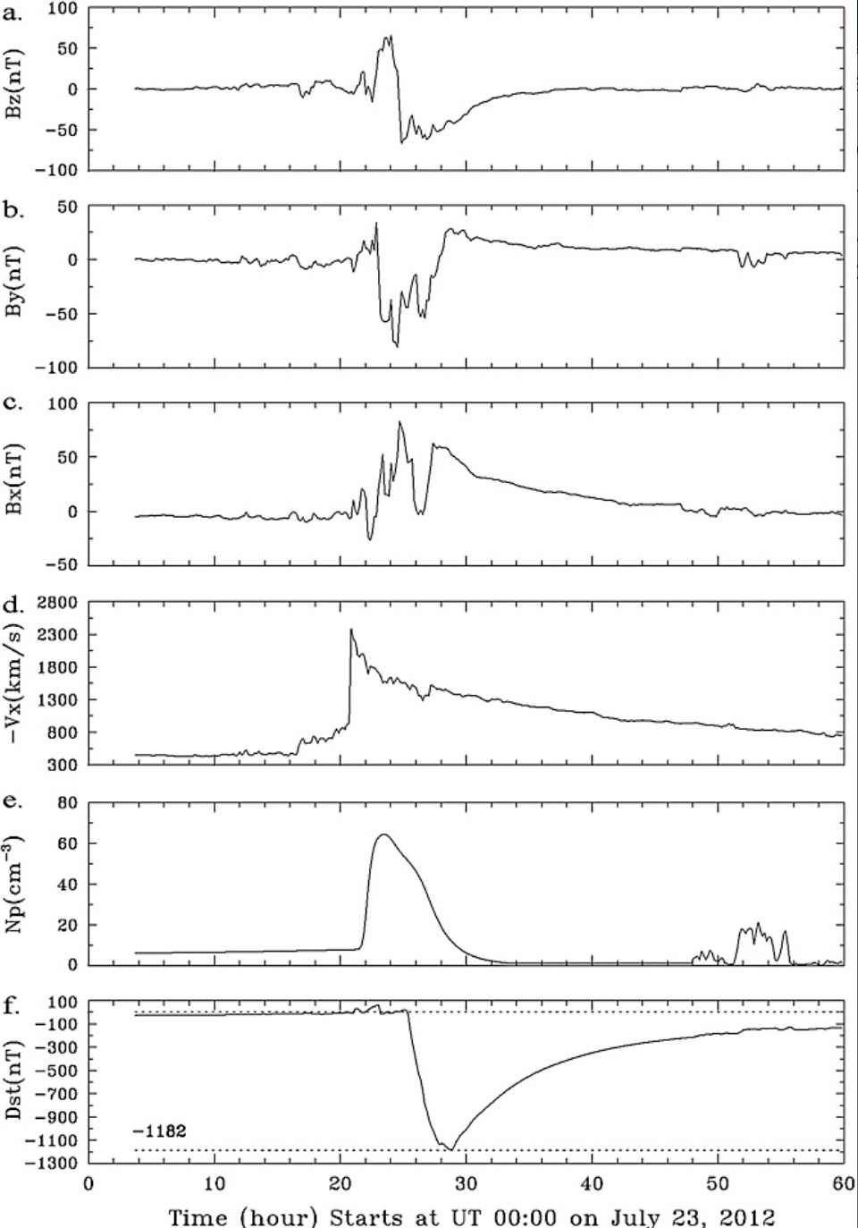
STEREO-A Event
STEREO-A observations of July 23, 2012 event. This is the most severe interplanetary event ever observed, but it did not hit Earth. However, it can serve as a benchmark of possible scenarios.
Left panel are the data as observed, with a model Dst calculated based on Earth’s dipole tilt on that day. Panel on the right shows a “worst case scenario” with maximum effective dipole tilt and SW density from ENLIL.
(from Baker et al., 2013)

Slide 4

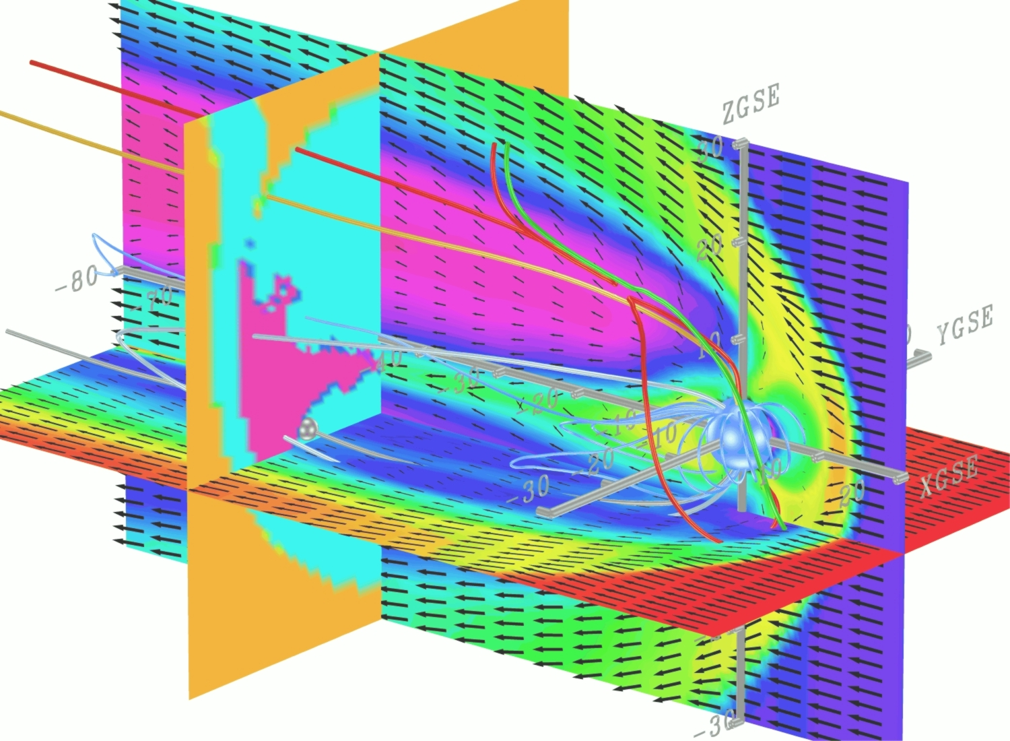
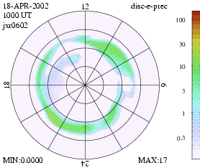
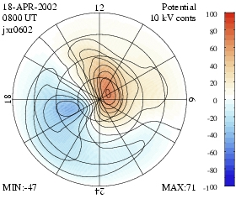
OpenGGCM: Global Magnetosphere Modeling
The Open Geospace General Circulation Model:
Coupled global magnetosphere - ionosphere - thermosphere model.
3d Magnetohydrodynamic magnetosphere model.
Coupled with NOAA/SEC 3d dynamic/chemistry ionosphere - thermosphere model (CTIM).
Coupled with inner magnetosphere / ring current models: Rice U. RCM, NASA/GSFC CRCM.
Model runs on demand (>500 so far) provided at the Community Coordinated Modeling Center (CCMC at NASA/GSFC).
http://ccmc.gsfc.nasa.gov/
Fully parallelized code, real-time capable. Runs on IBM/datastar, IA32/I64 based clusters, PS3 clusters, and other hardware.
Used for basic research, numerical experiments, hypothesis testing, data analysis support, NASA/THEMIS mission support, mission planning, space weather studies, and Numerical Space Weather Forecasting in the future.
Funding from NASA/LWS, NASA/TR&T, NSF/GEM, NSF/ITR, NSF/PetaApps, AF/MURI programs.
Aurora
Ionosphere Potential
Personnel: J. Raeder, K. Germaschewski, Doug Cramer, B. Ferdousi, S. Kavosi (UNH), T. Fuller-Rowell, N. Muriyama (NOAA/SEC), F. Toffoletto, S. Sazykin (Rice U.), M.-C. Fok (GSFC), A. Richmond, A. Maute (NCAR)

Slide 5
Approach
Use OpenGGCM, coupled with CTIM (ionosphere-thermosphere) and RCM (ring current) to model a sequence of increasingly strong storms.
Objective: assessment of storm effects on the magnetosphere (magnetopause, ring current, radiation belts, …) and ionosphere (TEC, open-closed boundary, …). Also, provide inputs for other ionosphere – thermosphere – (atmosphere) models.
Why not model Carrington event or SEREO-A event right away: model may crash, difficult to see if results are reasonable.
Scaling up storms allows us to (1) verify model at original driver’s strength, (2) see what changes occur when forcing increases, i.e., how parameters scale, and (3) get more clues to understand the physics.

Slide 6
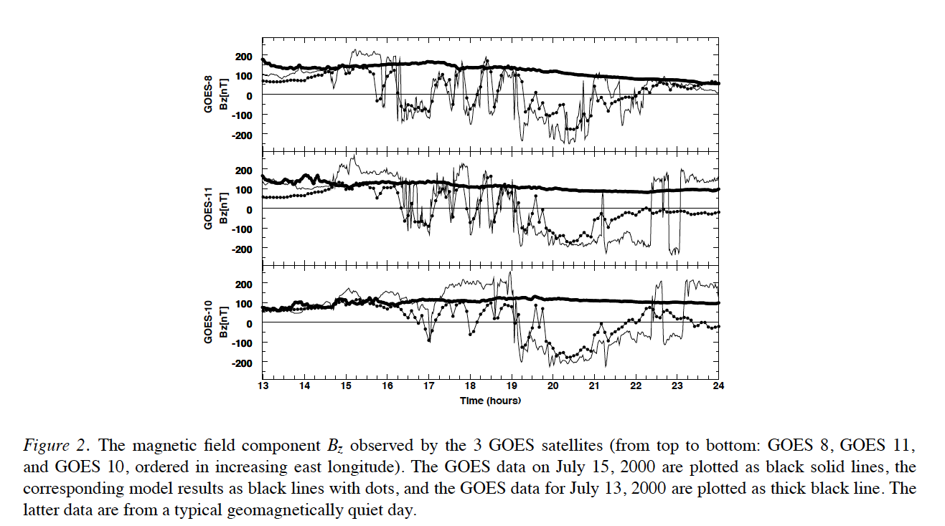
Older Results: Bastille Day Storm
Fairly good prediction of GOES s/c exiting and entering the magnetosphere.
Model shows MP nose moves all the way in to 4.9 RE.
One GOES s/c gets close to crossing the bow shock.

Slide 7
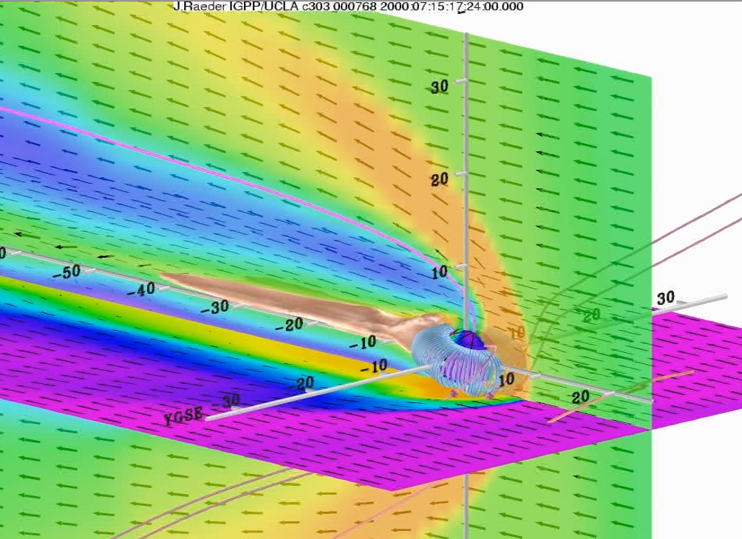
Older Results: Bastille Day Storm
3 GOES s/c exit the magnetosphere and get close to the bow shock on 2007-07-15.

Slide 8
A scaled-up storm
We ran 2 simulations of the 2000-06-04 storm.
Fairly strong CME type storm with Dst ~ -300 nT.
IMF Bz ~ -30 nT for half a day, Vsw ~ 600 km/s.
Also very high SW density up to 50 cc.
We then ran a second simulation where both IMF Bz and Vsw were increased by 50%.
The following movie frames compares northern PC potential, e- precipitation flux, and TEC.
Both simulations were run with RCM on, and CTIM for the IT system.

Slide 9
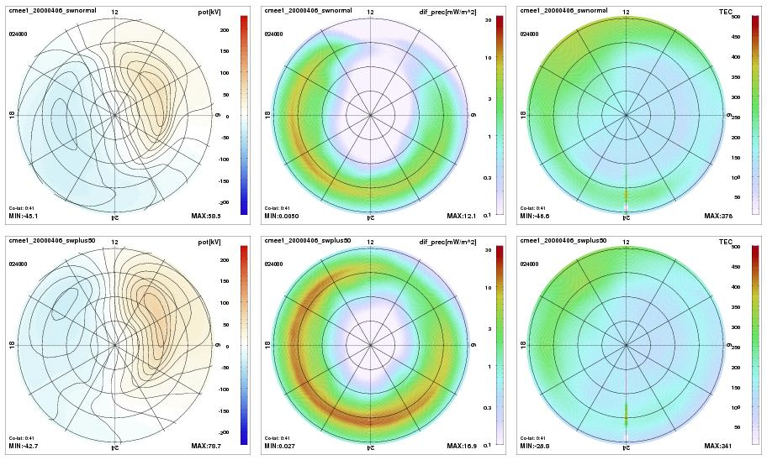
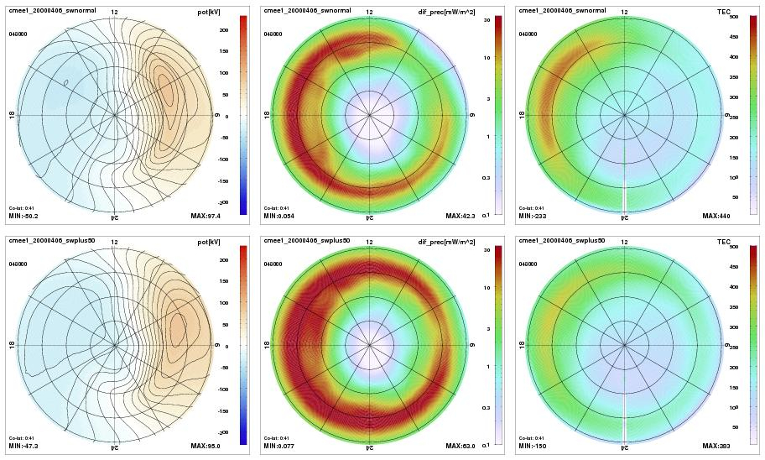
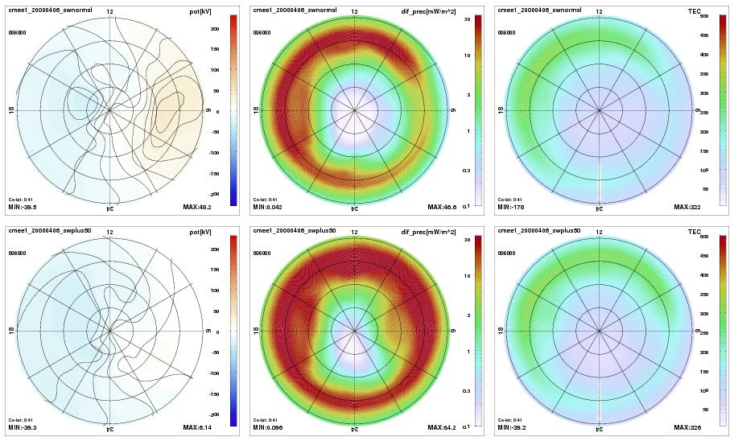
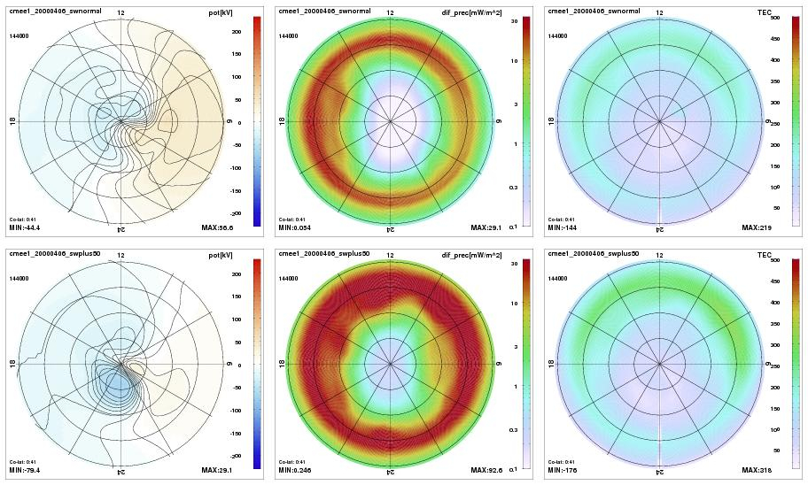
Top: unscaled, bottom: scaled, left: potential, middle: e- precipitation, right: TEC

Slide 10
2000-04-06 Storm
Top row: original storm
Bottom row: Bz/Vsw increased by 50%
Left: potential, middle: e- precipitation, right: TEC
At 4 different times.
Potential: stronger in the beginning, but not much different in the later phases of the storm, except in recovery: potential drops much quicker because of higher precipitation (RC still loaded?)
Electron precipitation: much stronger throughout, but in particular in the later phases. This may explain subdued potential due to increased conductance. Precipitation also extends both to higher and lower latitudes. It appears as though the inner magnetosphere gets more strongly loaded in the main phase and only slowly recovers.
TEC: very mixed. Sometimes higher with the stronger storm, but sometimes more of a negative storm effect.

Slide 11
Another Storm Scaled Up
We also ran 2 simulations of the 2001-04-11 storm.
Fairly strong CIR? type storm with Dst ~ -300 nT.
IMF Bz ~ -20 nT for half a day, Vsw ~ 600 km/s.
Recovery phase looks like CME with N-S axis (Bx-By rotations)
Also very high SW density up to 50 cc during main phase.
We then ran a second simulation where both IMF Bz and Vsw were increased by 50%.

Slide 12
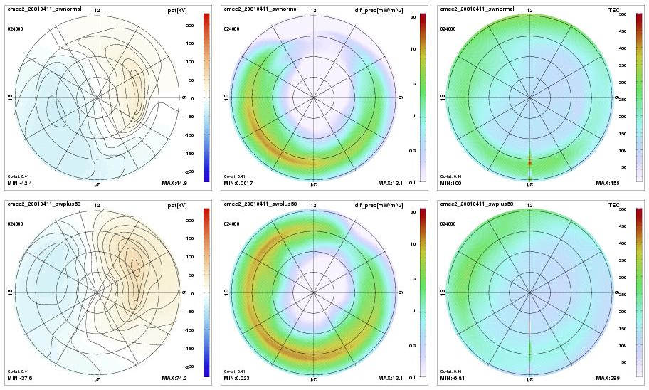
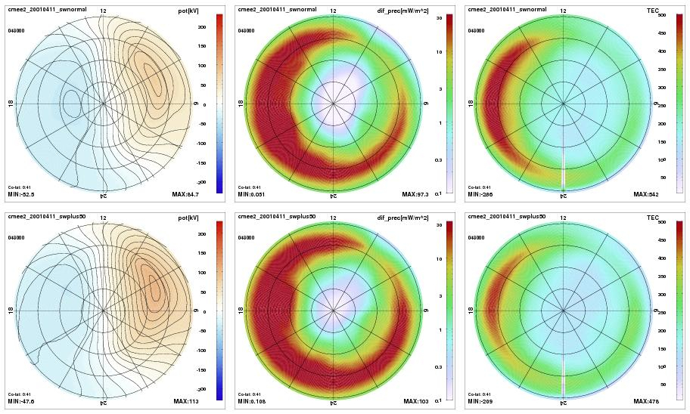
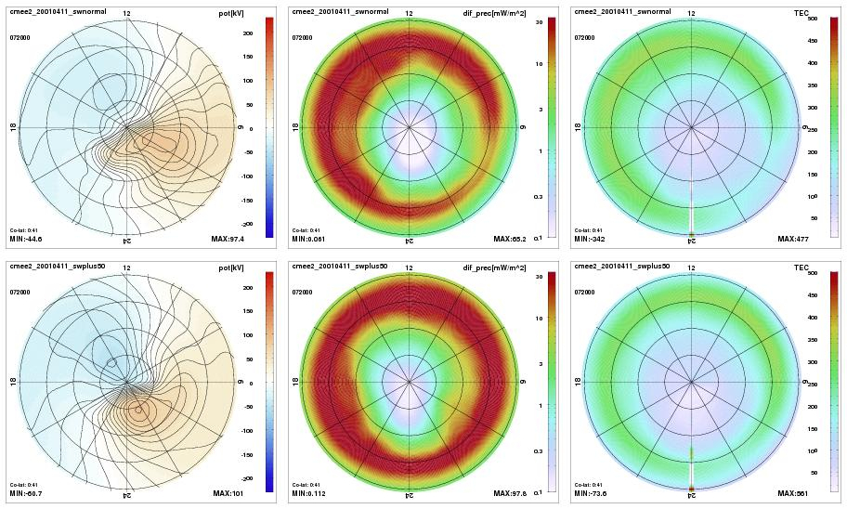
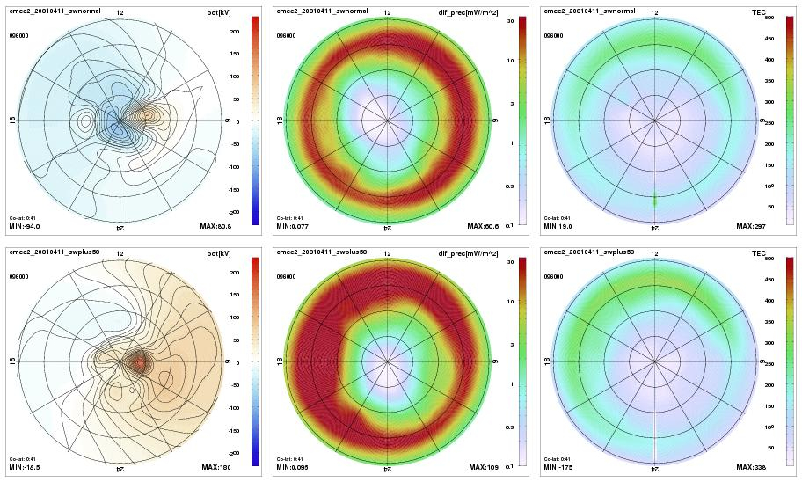
Top: unscaled, bottom: scaled, left: potential, middle: e- precipitation, right: TEC

Slide 13
2001-04-11 Storm Simulations
Similar results compared to the other storm, although SW driver is very different.
In the main and recovery phases, both the positive and negative TEC responses are weaker in the scaled-up storm.
All simulations lack SED because of CTIM limitations.
All simulations show penetration of potential lo mid latitudes.
All simulations show saturation of potential. Note that SW e-field is scaled-up to 2.25 of its original value.

Slide 14
Summary
We can simulate large storms w/OpenGGCM giving reasonable results.
Initial results simulating scaled-up storms yield some interesting results, including reduced TEC response for stronger storms.
A long TODO list:
  Verify as much as possible w/data.
  Replace CTIM with IPE.
  Look at inner magnetosphere and Dst.
  Use magnetosphere drivers for more sophisticated IT-(atmosphere) models.
  Examine different kinds of storms.
  Quantify electric field penetration.
  Quantify saturation effects.
  Quantify response limits for TEC and other variables.
  Understand the physics behind the “observed” phenomena.

Slide 15
Acknowledgements
This research was supported by AFOSR grant FA9550-18-1-0483 “Understanding and Predicting the Space Weather Impact of Extreme Solar Storms.”
I’m looking to hire a researcher to pursue this research.
If interested, email me at j.raeder@unh.edu

Slide 16
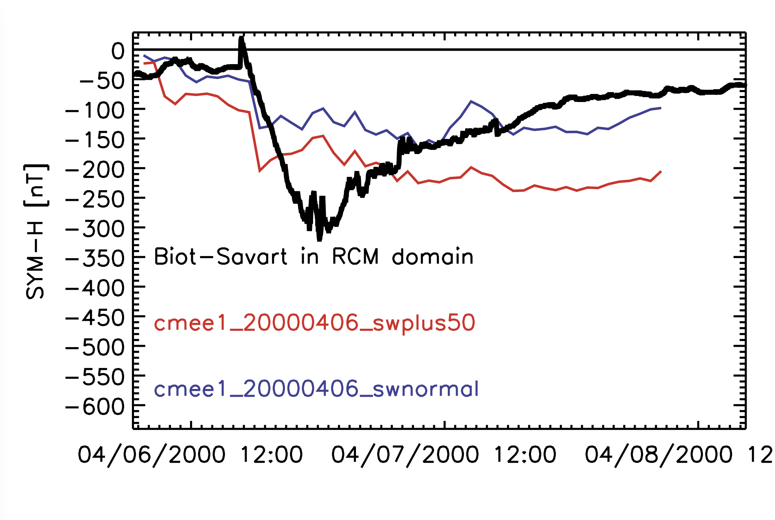
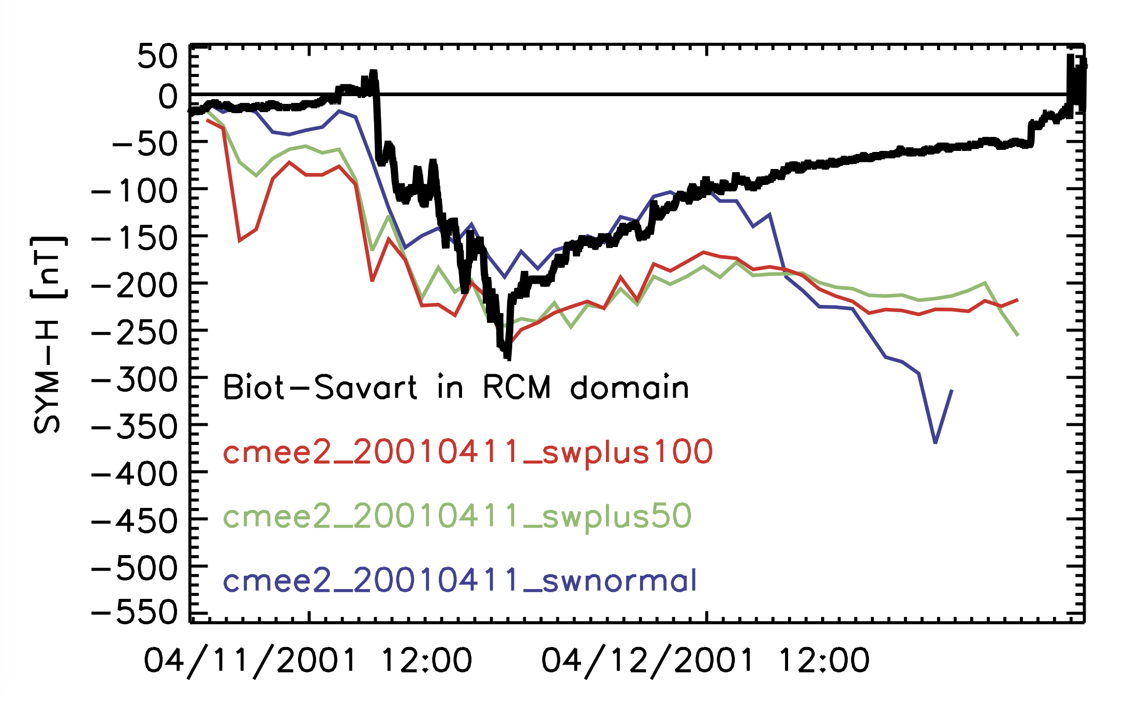
Dst Comparisons

