Slide 1
Recent “extreme Space Weather” OpenGGCM Results
AFOSR meet, January15-17, 2019

Slide 2
A scaled-up storm
We ran 2 simulations of the 2004-06-04 storm.
Fairly strong CME type storm with Dst ~ -300 nT.
IMF Bz ~ -30 nT for half a day, Vsw ~ 600 km/s.
Also very high SW density up to 50 cc.
We then ran a second simulation where both IMF Bz and Vsw were increased by 50%.
The following movie compares northern PC potential, e- precipitation flux, and TEC.
Both simulations were run with RCM on, and CTIM for the IT system.

Slide 3
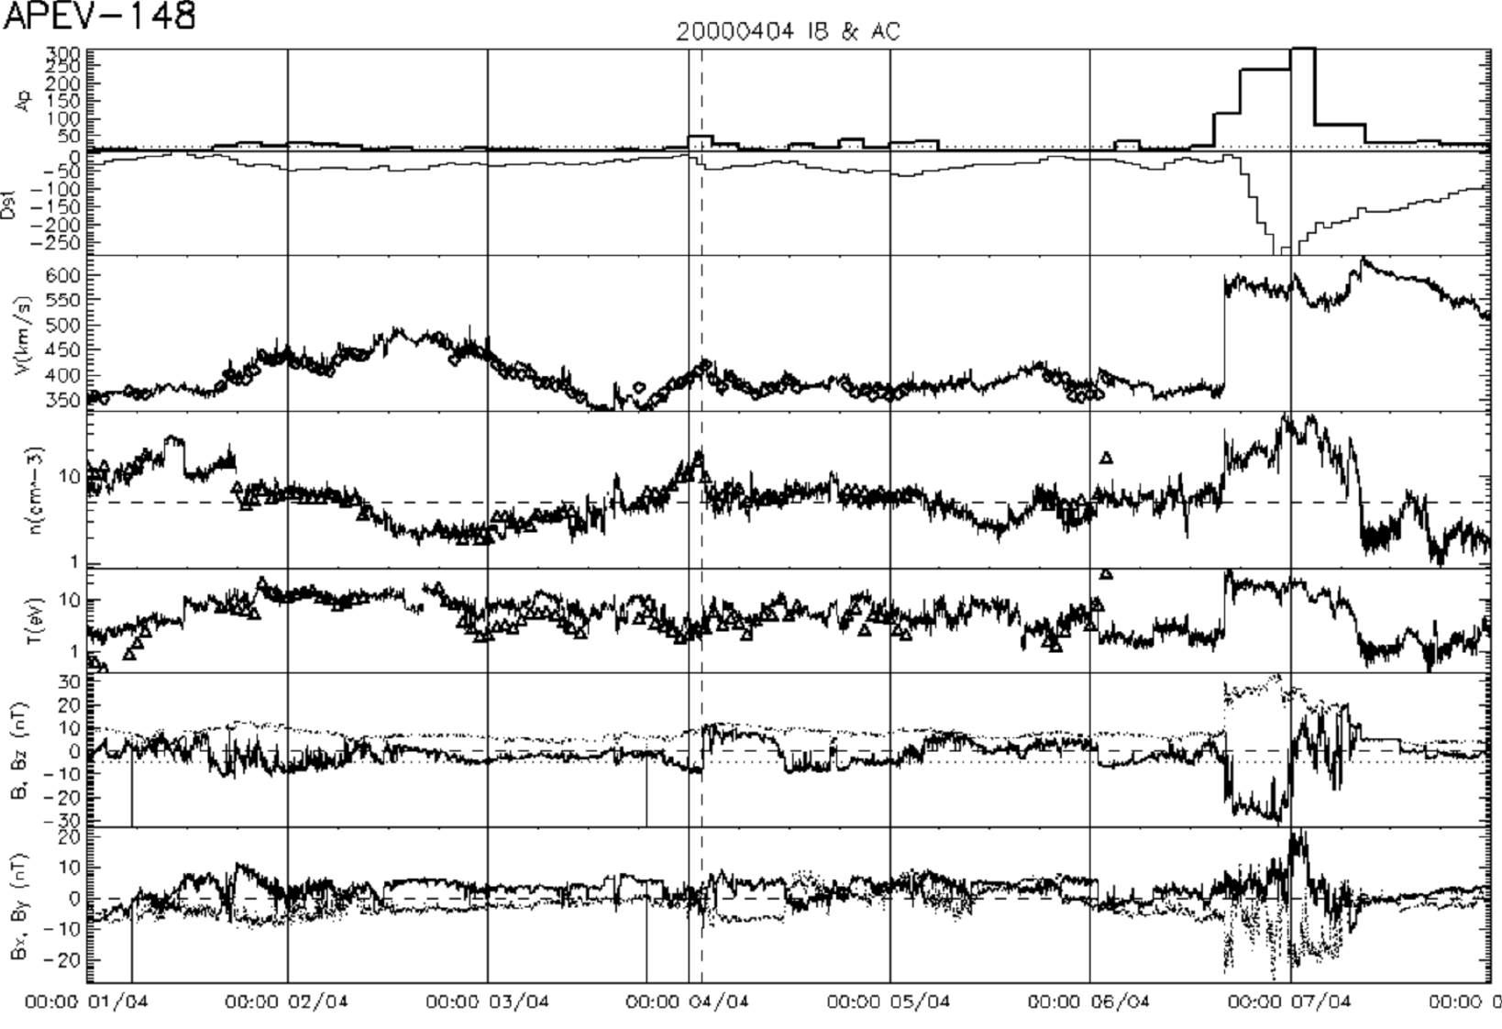
2000-04-06 storm parameters

Slide 4
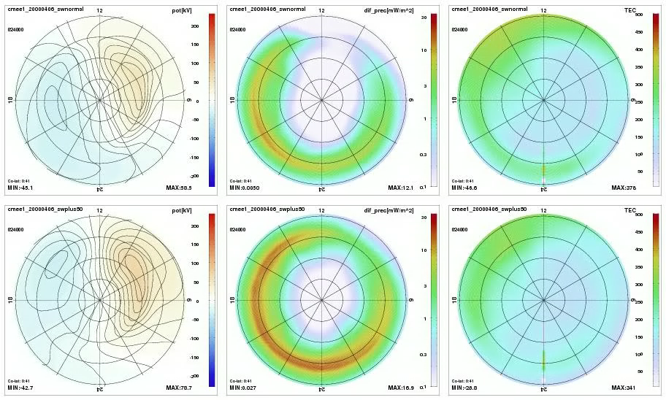
2000-04-06 storm simulations

Slide 5
2000-04-06 simulations
Top row: original storm
Bottom row: Bz/Vsw increased by 50%
Left: potential, middle: e- precipitation, right: TEC
Potential: stronger in the beginning, but not much different in the later phases of the storm.
Electron precipitation: much stronger throughout, but in particular in the later phases. This may explain subdued potential due to increased conductance. Precipitation also extends both to higher and lower latitudes. It appears as though the inner magnetosphere gets more strongly loaded in the main phase and only slowly recovers.
TEC: very mixed. Sometimes higher with the stronger storm, but sometimes more of a negative storm effect (Tim, you may be able to say more about this). Some indication of SAPS, but probably at lower latitude than we are showing here.

