Slide 1
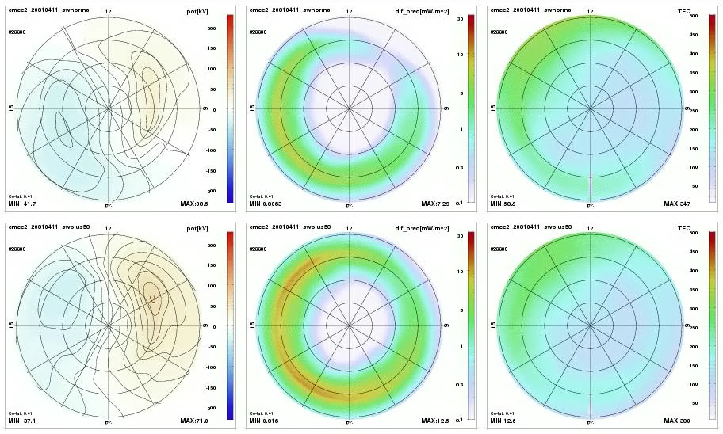
We ran 2 OpenGGCM simulations of the 2004-06-04 storm. Fairly strong CME type storm with Dst ~ -300 nT, IMF Bz ~ -30 nT for half a day, Vsw ~ 600 km/s, very high SW density up to 50 cc. We then ran a second simulation where both IMF Bz and Vsw were increased by 50%. top: original IMF and solar wind bottom: Vx*1.5 and Bz*1.5 left: potential, middle: e- precipitation, right: TEC
Raeder (UNH) & Fuller-Rowell (CU): Space Weather Impact of Extreme Solar Storms
Potential: stronger in the beginning, but not much different in the later phases of the storm.
Electron precipitation: much stronger throughout, but in particular in the later phases. This may explain subdued potential due to increased conductance. Precipitation also extends both to higher and lower latitudes. It appears as though the inner magnetosphere gets more strongly loaded in the main phase and only slowly recovers.
TEC: very mixed. Sometimes higher with the stronger storm, but sometimes more of a negative storm effect. Some indication of SAPS, but probably at lower latitude than we are showing here.

