Slide 1
Sun to Earth Geomagnetic Storm Predictions with EUHFORIA and OpenGGCM
Jimmy Raeder and Doug Cramer
Space Science Center, University of New Hampshire, Durham, NH
Camilla Scolini, Stefaan Poedts & Emmanuel Chane
KU Leuven, Leuven, Belgium
Fundamental Physical Processes in Solar-Terrestrial Research
and Their Relevance to Planetary Physics 2018
Kona, Hawaii, 7-13 January 2018

Slide 2
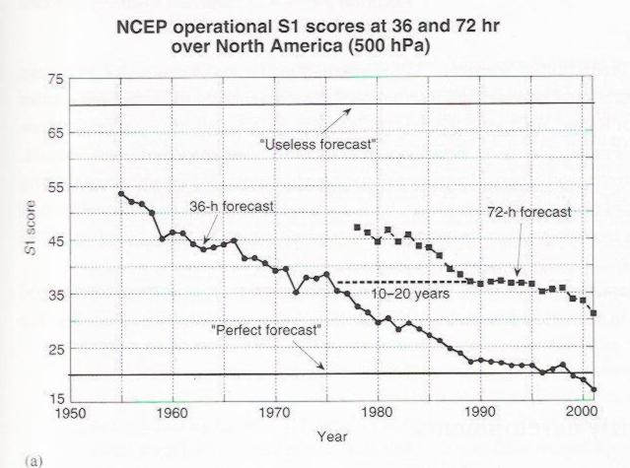
Why Sun to Earth forecasts?
We need lead times better than 20 minutes L1 – Earth.,
Weather forecasts have shown dramatic improvements over the past 60(!) years.
These improvements are largely due to better models, the use of data assimilation, and better data coverage.
Yes, we would like to have that for the magnetosphere too.
From: Kalnay, 2003

Slide 3
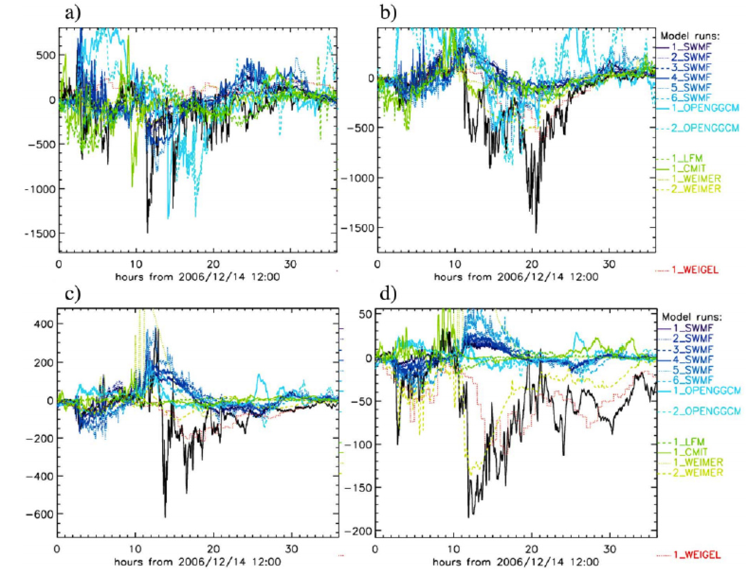
Current Global Geospace Models Stink!
Even with L1 data as input.
From Pulkkinen et al., 2013

Slide 4
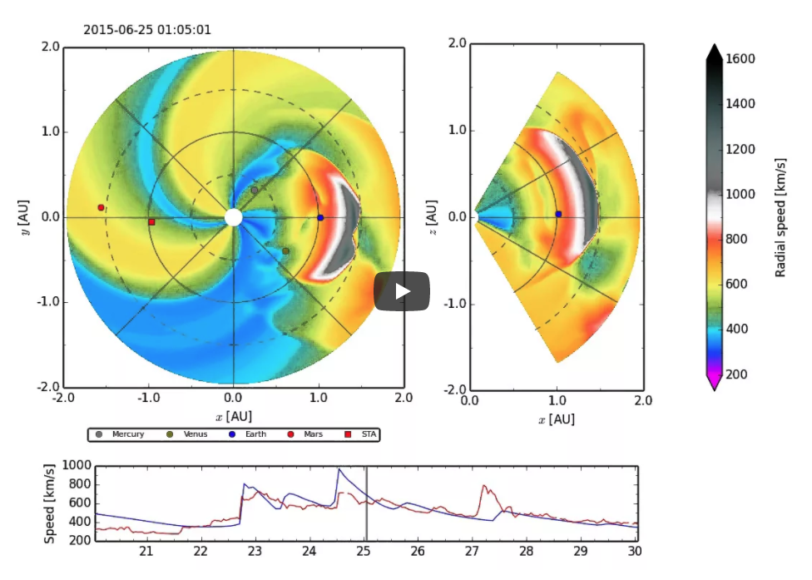
EUHFORIA: EUropean Heliospheric FORecasting Information Asset
Basically the European ENLIL
Coronal model for plasma conditions at 0.1 AU
GONG LOS observations + PFSS extrapolation
MHD from 0.1 to ~2 AU
CMEs can be injected based on coronal observations
CMEs are fits to flux tubes extending from the solar surface

Slide 5
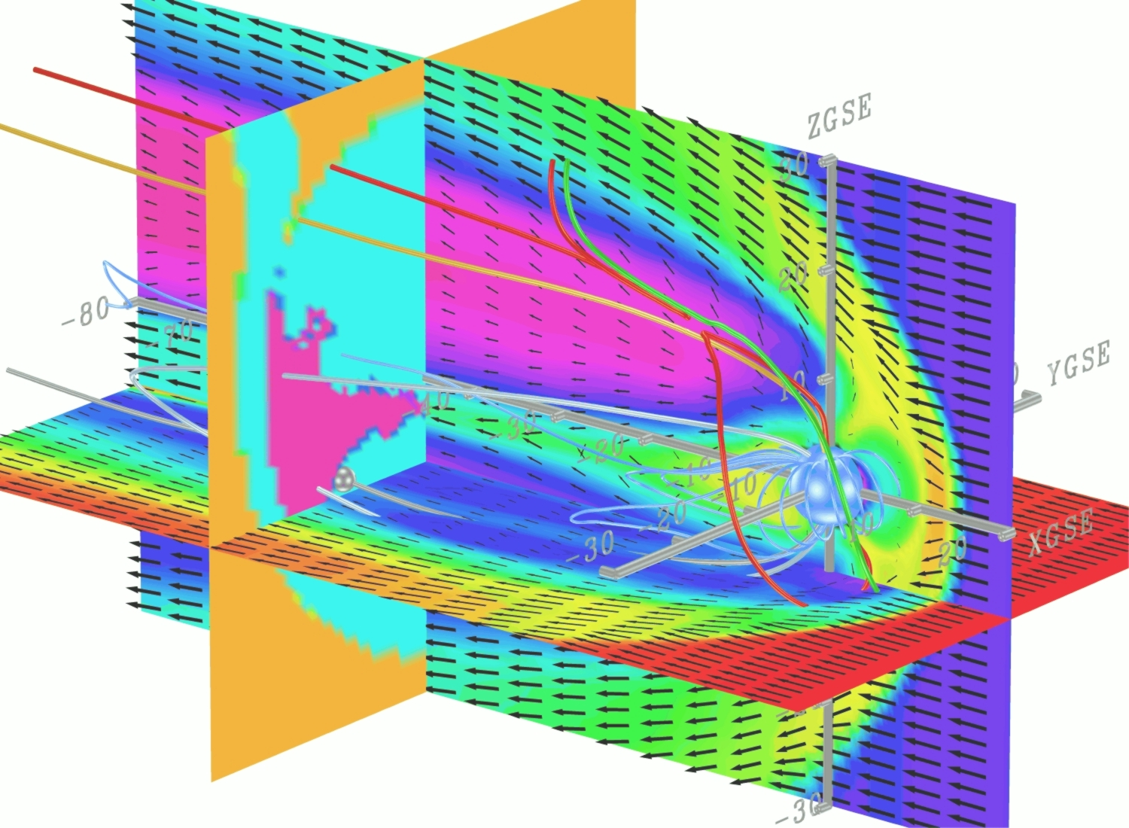
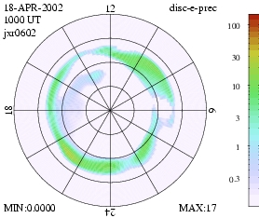
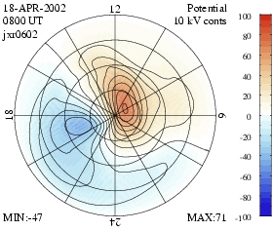
OpenGGCM: Global Magnetosphere Modeling
The Open Geospace General Circulation Model:
Coupled global magnetosphere - ionosphere - thermosphere model.
3d Magnetohydrodynamic magnetosphere model.
Coupled with NOAA/SEC 3d dynamic/chemistry ionosphere - thermosphere model (CTIM).
Coupled with inner magnetosphere / ring current models: Rice U. RCM, NASA/GSFC CRCM.
Model runs on demand (>500 so far) provided at the Community Coordinated Modeling Center (CCMC at NASA/GSFC).
http://ccmc.gsfc.nasa.gov/
Fully parallelized code, real-time capable. Runs on IBM/datastar, IA32/I64 based clusters, PS3 clusters, and other hardware.
Used for basic research, numerical experiments, hypothesis testing, data analysis support, NASA/THEMIS mission support, mission planning, space weather studies, and Numerical Space Weather Forecasting in the future.
Funding from NASA/LWS, NASA/TR&T, NSF/GEM, NSF/ITR, NSF/PetaApps, AF/MURI programs.
Personnel: J. Raeder, K. Germaschewski, D. Cramer, L. Wang, K. Maynard, D. Arel, J. Jensen (UNH), T. Fuller-Rowell, N. Muriyama (NOAA/SEC), (Rice U.), M.-C. Fok, H.-J. Connor (GSFC), T. Matsuo (CU), J. Anderson, T. Hoar (NCAR)
Aurora
Ionosphere Potential

Slide 6
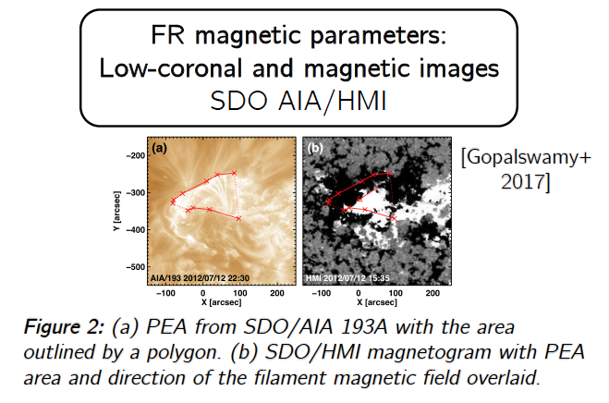
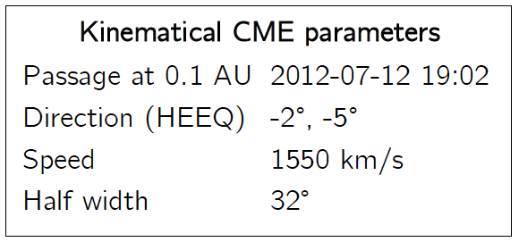
CME Input
FR parameters – test run
Positive helicity
6.6x10^13 Wb flux
Tilt angle set to maximize Bz
CME speed scaled to match arrival time (1300 km/s

Slide 7
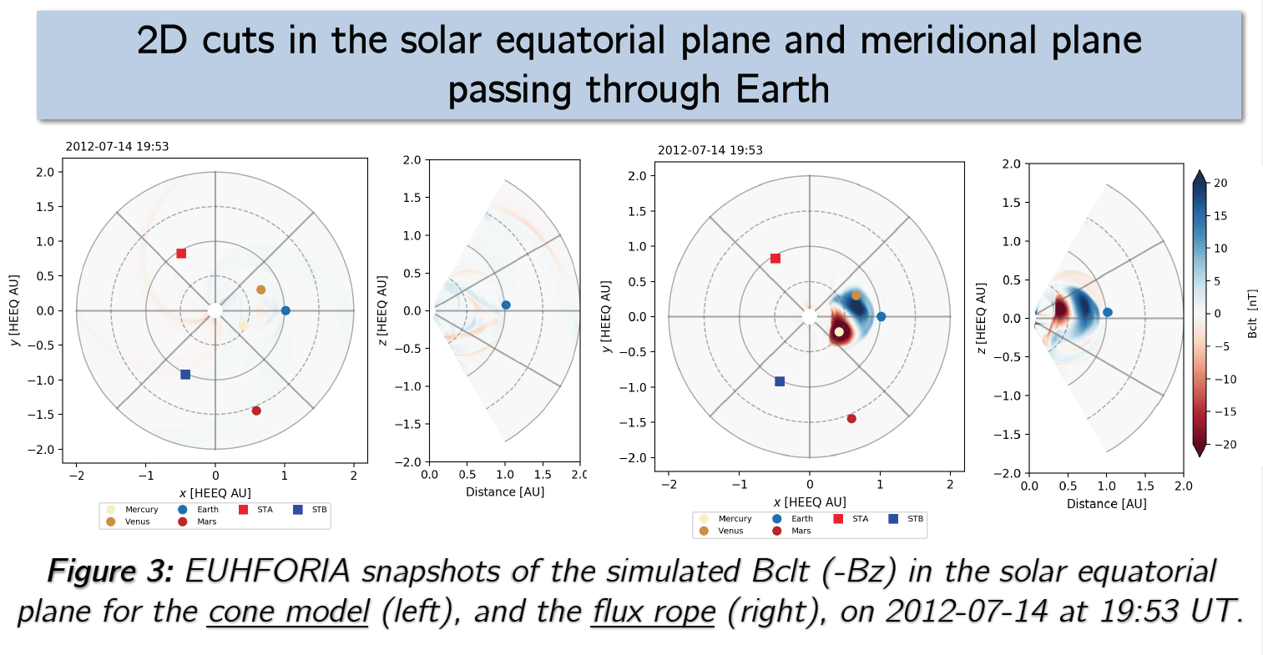
CME Modeling

Slide 8
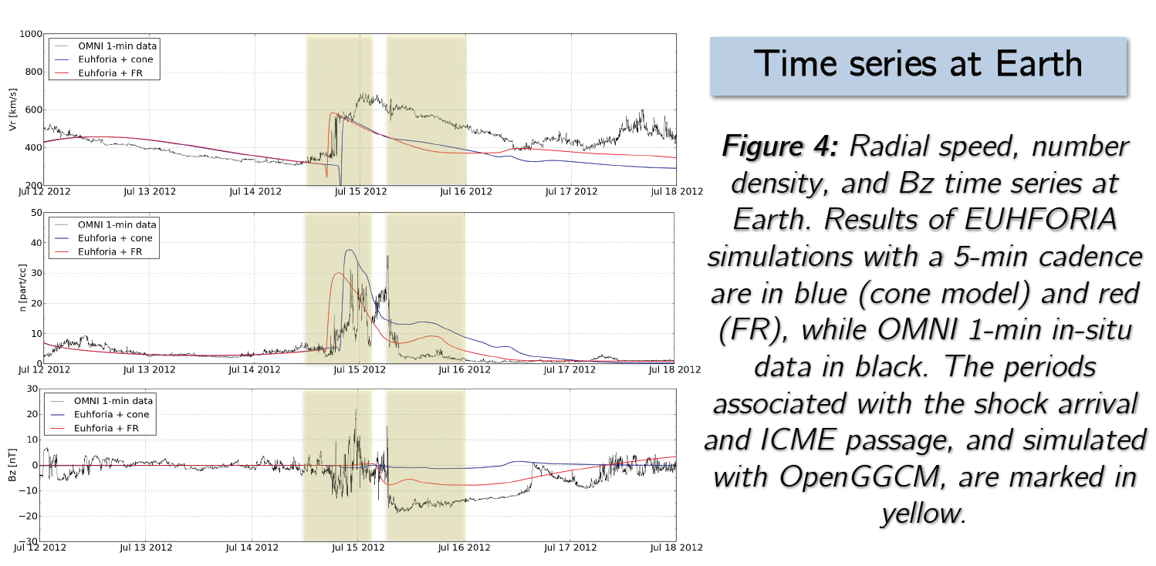
CME Modeling

Slide 9
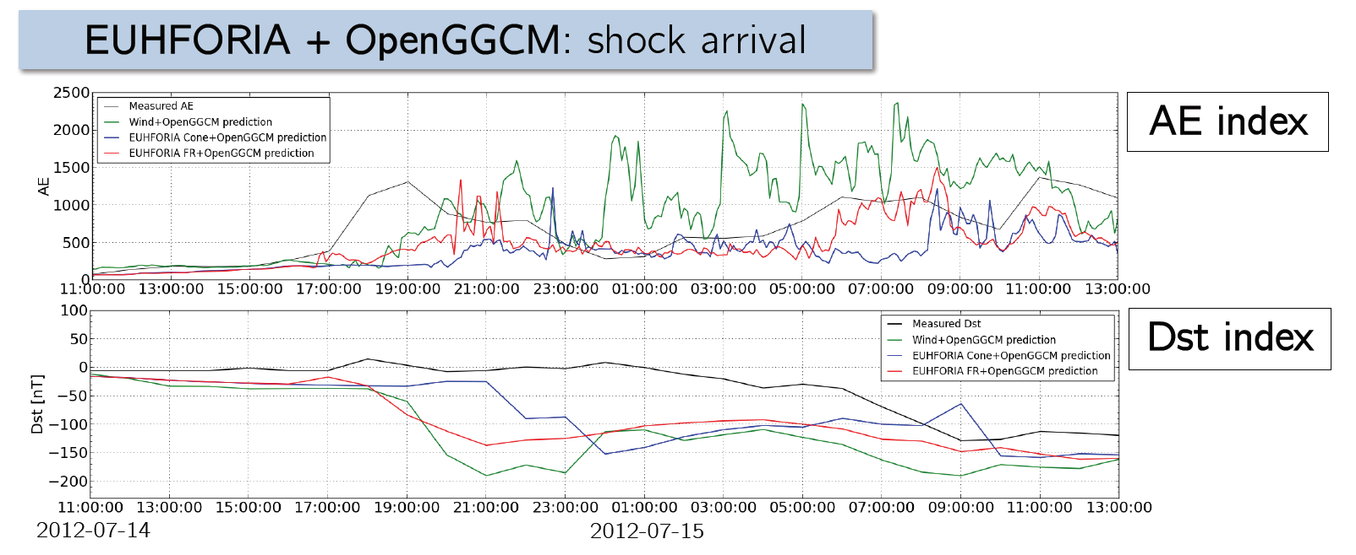
Geospace @ IS Arrival
With inputs from Wind+OpenGGCM (green), EUHFORIA-cone+OpenGGCM (blue), and EUHFORIA-FR+OpenGGCM (red). Data are in black.

Slide 10
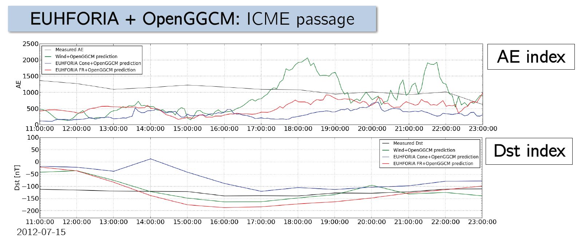
Geospace CME passage
With inputs from Wind+OpenGGCM (green), EUHFORIA-cone+OpenGGCM (blue), and EUHFORIA-FR+OpenGGCM (red). Data are in black.

Slide 11
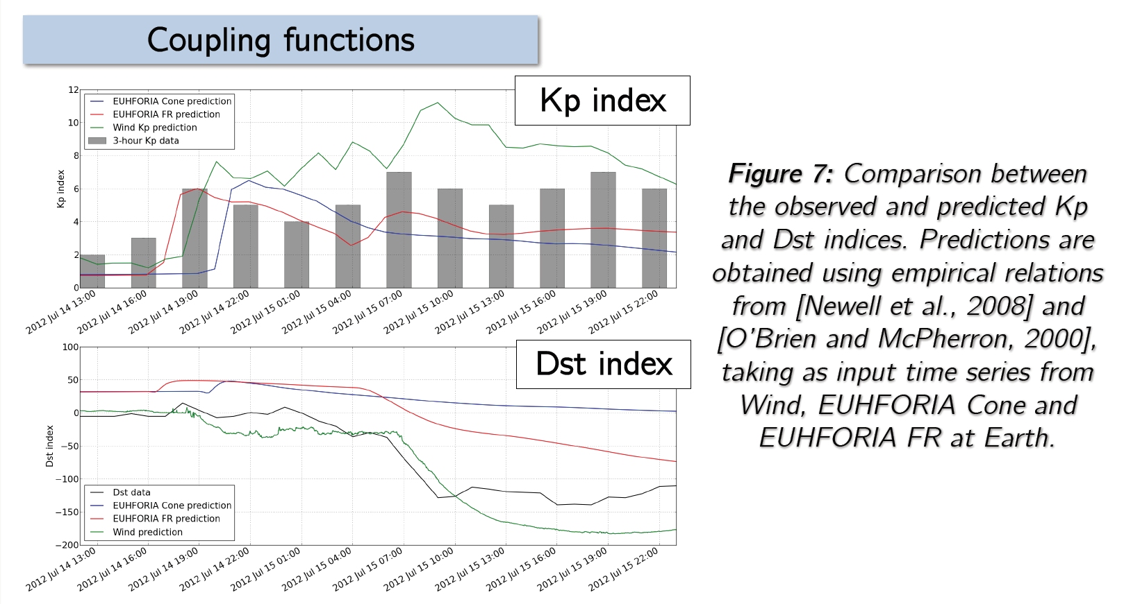
With Coupling Functions
Instead of using OpenGGCM, using simple coupling function for Kp (Newell et al., 2008) and Dst (O’Brien & McPherron, 2000)

Slide 12
Summary & Conclusions
First attempt of sun-to-mud simulation of CME storm with EUHFORIA-OpenGGCM.
Generates a reasonable Bz signature at L1.
Dst and AE signatures at Earth are reasonably produced.
They even seem a bit better with L1 predictions than with OMNI data (!?)
Even without the CME flux rope one gets a storm, but it looks different.

